Slide 1

Medical Technologies : force of change
By Vincent Bernière
Anglais Master 1 GIL
2015-2016

Slide 2
Introduction
Identify risk factors for disease
better prevention and management of diseases
new technological approaches
collaboration between researchers and engineers, biologists and physicians
In what measure can we say that technologies will revolutionize the medical sector?
Vincent Bernière Medical technologies : force of change
Notes:
While taking into account the comfort patient….
All challenges to the better prevention …
These approaches today are the result of close collaboration between..

Slide 3
Plan
1 How is medical technology defined?
2 The issues and benefits of medical technology
3 The medical profession is divide
Vincent Bernière Medical technologies : force of change
Notes:
Firsly, i will define the medical technology
Secondly, i will talk about the issues and benefits of medical technology.
And last, the use of technology in the health sector continues to divide the medical profession

Slide 4
Introduction
1. How is medical technology defined
2. The issues and benefits of medical technology 3. The medical profession is divide
Conclusion
1. How is medical technology defined
These new health technologies fall into 4 main areas :
Imagery
Drugs
Biotechnology and bioengineering
surgery and interventional techniques
Vincent Bernière Medical technologies : force of change 4/11
Notes:
Medical technology can be considered as any technology used to save lives in individuals suffering from a wide range of conditions.
This is all the anatomical and functional imaging technology, cellular and molecular.
The emergence of new drugs result of a long and costly process.
This area covers all diagnostic technologies and analysis, their implantation in the living and biomaterials related to regenerative medicine and bio-production.
Surgical technologies include many methods and knowledge that the fundamental issue is to minimize the risk of complications for the patien and reduce the response time as hospitalization.

Slide 5
Introduction
1. How is medical technology defined
2. The issues and benefits of medical technology 3. The medical profession is divide
Conclusion
1. How is medical technology defined
Instrument
Apparatus
Appliance
Software
Material
Diagnostic
And Therapeutic purposes
Vincent Bernière Medical technologies : force of change 5/11
Notes:
Any instrument, device, appliance, software, material, whether used alone or in combination, including the sotware intended by its manufacturer to be used specifically for diagnostic and/or therapeutic purposes.

Slide 6
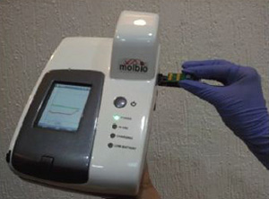
Introduction
1. How is medical technology defined
2. The issues and benefits of medical technology 3. The medical profession is divide
Conclusion
2. The issues and benefits of medical technology
The common thread through all applications of medical technology is the beneficial impact on health and quality of life.
A Canadian institute is working on the development of technologies
for poor countries.
A portable analyzer who detect diseases faster and quickly than
conventional methods.
Vincent Bernière Medical technologies : force of change 6/11
Notes:
They all contribute to living longer, better and empowering citizens to contribute to society for longer. In Europe, medical technology is also a major contributor to the economy, emplying 575 000 people in hight quality jobs.
A Canadian institute … to detect diseases quickly.
With the funding allocated , scientists have already developed a portable analyzer capable of detecting malaria easily. The analyzer determines the kind of parasite and the proportion of infected red blood cells. This replaces, for a limited cost, lengthy operations conducted by a specialized laboratory, and this in less than an hour.

Slide 7
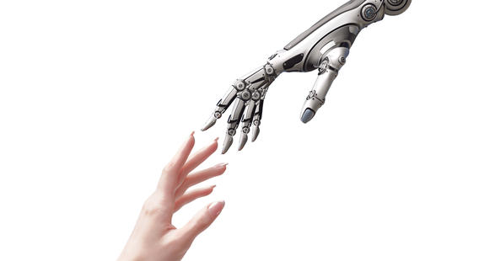
Introduction
1. How is medical technology defined
2. The issues and benefits of medical technology 3. The medical profession is divide
Conclusion
2. The issues and benefits of medical technology
Robotic revelations
Robotics services : personal robot, dependency, monitoring…
Remote support
Rehabilitation
"smart" assistants or multitasking
Physical assistance : prostheses, exoskeletons, …
Vincent Bernière Medical technologies : force of change 7/11
Notes:
One of the great revolution in the health sector is the medical robotics !
Robotics much progress in the areas of health ( robotic surgery , rehabilitation ) assistance to the person ( companion " personal robot " , monitoring , dependency, disability, etc.). We are witnessing a revolution in robotics services.
The aging population demographics in the world and the increasing number of motor or sensory disabilities incentive to implement various systems such as remote support , physical assistance, rehabilitation , or "smart" assistants or multitasking . For example: prostheses, exoskeletons , companions robots ( cognitive, social , and physical security ).
Today, we can manipulate the prostheses by thought and be assist in a chiurgie by a robot. But for now very few hospitals use these innovations.

Slide 8
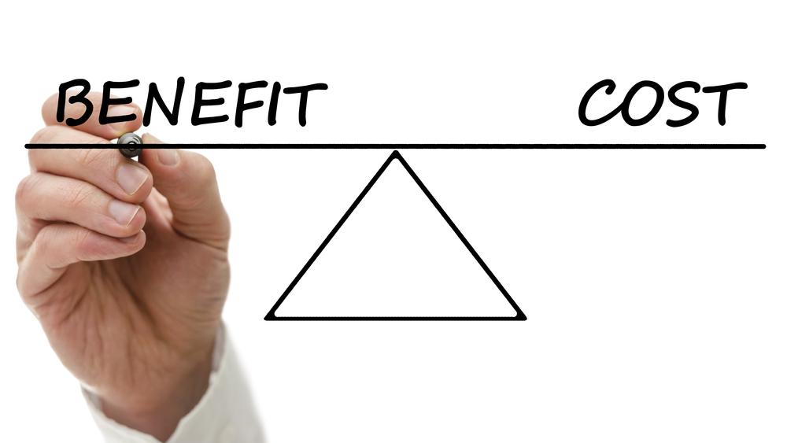
Introduction
1. How is medical technology defined
2. The issues and benefits of medical technology 3. The medical profession is divide
Conclusion
3. The medical profession is divide
Medical technology :
Their adoption changes the balance of resources and increases the cost of care
Poor countries should sacrifice the primary level services
Rich countries find a balance between the needs and demand
Vincent Bernière Medical technologies : force of change 8/11
Notes:
Advances in technology, new drugs and new diagnostic tools, for example, can improve the health and overall performance of the healthcare system . But innovations also have drawbacks since their adoption changes the balance of resources and increases the cost of care.
To invest in modern medical technology , poor countries should sacrifice the primary level services that are of vital importance .
Rich countries must , for their part , find a balance between the needs of the general population and demand for advanced medical examinations, which tends to increase the overall cost of care.
The use of new technologies in the medical sector improves the quality of services: the majority of physicians recognize that this is indeed a time saver for them and allows better coordination of care. Therefore , many doctors who adopt technologies , but this adoption is far from being easy.

Slide 9

Introduction
1. How is medical technology defined
2. The issues and benefits of medical technology 3. The medical profession is divide
Conclusion
3. The medical profession is divide
Health Information Technology :
57% refuse to use mobile health technology
44 % do not want to use personal devices
29% are concerned about patient privacy
26 % believe the applications are not suitable to the needs of doctors
Vincent Bernière Medical technologies : force of change 9/11
Notes:
A justified distrust
A large number of doctors (57%) refuse to use mobile health technology ( tablets and smartphones ) for clinical purposes . 44 % of them , in fact , do not want to use personal devices , 29% are concerned about patient privacy, and 26 % believe the applications and proposed programs are not suitable to the needs of doctors. In addition , many doctors are skeptical regarding the clinical value of these technologies and are mindful of the implementation costs.

Slide 10
Introduction
1. How is medical technology defined
2. The issues and benefits of medical technology 3. The medical profession is divide
Conclusion
Conclusion
Move to the technologies…
In the near futur, the robotics in all hospitals ?
A majority of doctors appreciate the transition.
How long will the refractory doctors to adopt them ?
Vincent Bernière Medical technologies : force of change 10/11
Notes:
To conclude, we can say that the medical community is moving increasingly towards technologies. At the moment, the simple use of tablet, sotware, but in the near future , the robotics in all hospitals.
The trend seems to lean in favor of these new methods , the question is how long will the refractory doctors to adopt them.

Slide 11
Introduction
1. How is medical technology defined
2. The issues and benefits of medical technology 3. The medical profession is divide
Conclusion
Références
http://www.atelier.net/trends/articles/industrie-de-technologie-medicale-changer-de-modele-subsister_425211
http://www.eucomed.be/medical-technology
http://www.aviesan.fr/fr/aviesan/accueil/menu-header/instituts-thematiques-multi-organismes/technologies-pour-la-sante
http://www.youphil.com/fr/article/04707-les-nouvelles-technologies-au-service-du-diagnostic-medical?ypcli=ano
http://esante.gouv.fr/le-mag-numero-8/la-robotique-medicale-le-futur-de-la-e-sante
http://www.atelier.net/trends/articles/usage-technologies-domaine-de-sante-divise-toujours-corps-medical_422803
Vincent Bernière Medical technologies : force of change 11/11

